Slide 1

Main String Operations
Notes:
Yes, we continue to see String types in our lesson. In this lesson, we will cover which operations can be applied to String types in detail.

Slide 2
Table of Contents
Searching a String
Changing a String
Editing a String
Notes:
at the end of this lesson you will learn what is the immutability and will be able to search any string or character in a string and will be able to change a string based on several methods and will be able to edit a string in accordance with your needs.

Slide 3
Searching a String

Slide 4
Searching a String
string.startswith()
Starts searching from the beginning to the end.
string.endswith()
Starts searching from the very end to the beginning.
Notes:
..
To search patterns in a string there are two useful methods called .startswith() and .endswith() that search for the particular pattern in the immediate beginning or end of a string and return True if the expression is found or False if the expression is not found. yess. the main point that i would like to underline is that these two methods always give True or False as a result. ok? let’s dive into the examples for better understanding.

Slide 5
Searching a String(review pre-class)
Let’s take a look these pre-class examples :
Notes:
text = "www.clarusway.com"
print(text.endswith(".com"))
print(text.startswith("http:"))

Slide 6
Searching a String(review pre-class)
Let’s take a look these pre-class examples :
Notes:
text = "www.clarusway.com"
print(text.endswith(".com"))
print(text.startswith("http:"))

Slide 7
Changing a String

Slide 8
Changing a String
The formula syntax 👇
string.method(arguments)
Notes:
The changing a string methods return the copy of the str with some changes made.
How does the syntax work?
A string is given first (or the name of a variable that represents a string), then comes a period followed by the method name and parentheses in which arguments are listed.

Slide 9
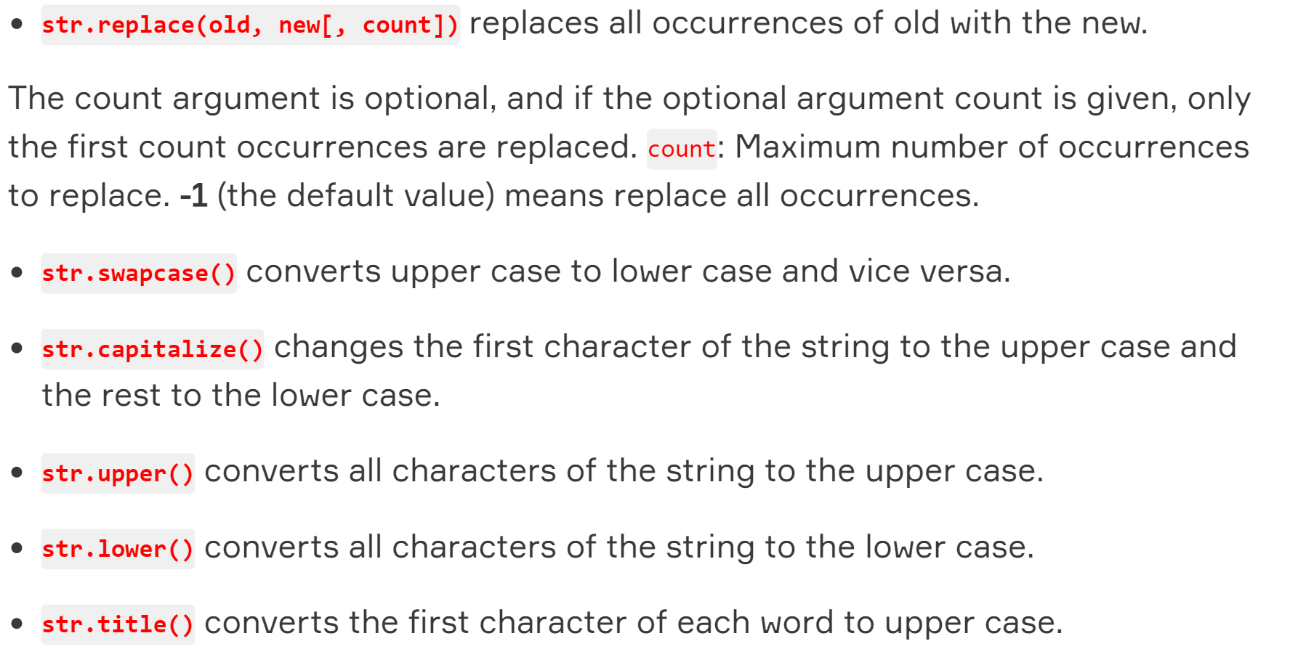
Changing a String
The summary of some common and the most important methods are as follows 👇

Slide 10
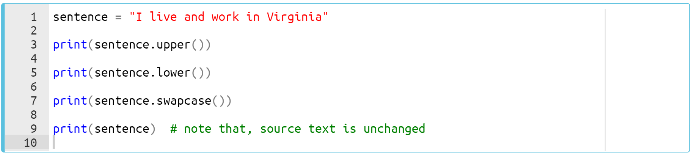
Changing a String
Let’s grasp these methods through the examples 👇
Notes:
sentence = "I live and work in Virginia"
print(sentence.upper())
print(sentence.lower())
print(sentence.swapcase())
print(sentence) # note that, source text is unchanged

Slide 11
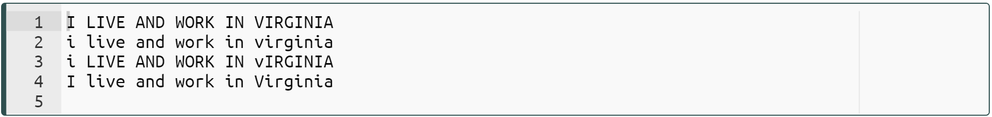
Changing a String
Let’s grasp these methods through the examples 👇
Notes:
sentence = "I live and work in Virginia"
print(sentence.upper())
print(sentence.lower())
print(sentence.swapcase())
print(sentence) # note that, source text is unchanged

Slide 12

Changing a String
💡Note that,
All these methods return str type.
So we can use the following syntax.
string.method1().method2().method3()...

Slide 13
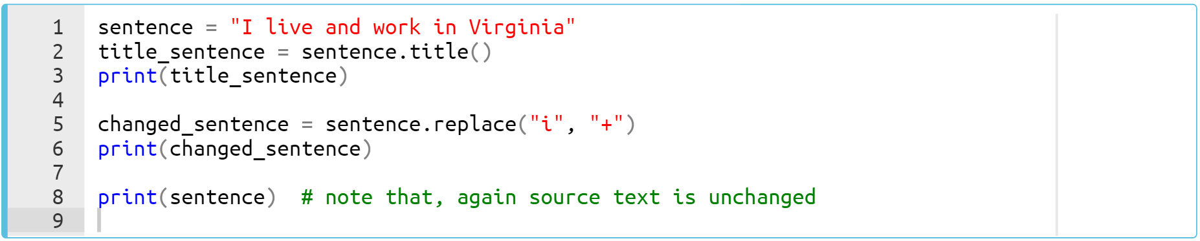
Changing a String
Let’s grasp these methods through the examples 👇
Notes:
so. in this example we are gonna see how we change the strings using basic string methods we learned just now…..
sentence = "I live and work in Virginia"
title_sentence = sentence.title()
print(title_sentence)
changed_sentence = sentence.replace("i", "+")
print(changed_sentence)
print(sentence) # note that, again source text is unchanged

Slide 14
Changing a String
Let’s grasp these methods through the examples 👇
Notes:
sentence = "I live and work in Virginia"
title_sentence = sentence.title()
print(title_sentence)
changed_sentence = sentence.replace("i", "+")
print(changed_sentence)
print(sentence) # note that, again source text is unchanged

Slide 15
Changing a String
Task 👇
Let’s change the first letters of each words to uppercase of the following text 👇
text = 'the better the family, the better the society'
Notes:
text = 'the better the family, the better the society'
text = text.title()
print(text)

Slide 16
Changing a String
The code may look like 👇
text = text.title()
print(text)
The Better The Family, The Better The Society
Notes:
.. ..
text = 'the better the family, the better the society'
text = text.title()
print(text)

Slide 17
Changing a String
Task 👇
In the text below, accidentally the number 0(zero) is used instead of the letter ‘o’ (oh). Fix them using .replace() method and change the value of the variable considering the new text and print the result.
text = 'S0d0me and G0m0re'
Notes:
text = 'S0d0me and G0m0re'
text = text.replace('0', 'o')
print(text)

Slide 18
Changing a String
The code may look like 👇
text = 'S0d0me and G0m0re'
text = text.replace('0', 'o')
print(text)
Sodome and Gomore
Notes:
text = 'S0d0me and G0m0re'
text = text.replace('0', 'o')
print(text)

Slide 19
Editing a String

Slide 20
Editing a String
The formula syntax 👇
string.method(arguments)
Notes:
The editing a string methods remove the trailing characters (i.e. characters from the right side).
The default for the argument chars is also whitespace. If the argument chars aren’t specified, trailing whitespaces are removed.

Slide 21
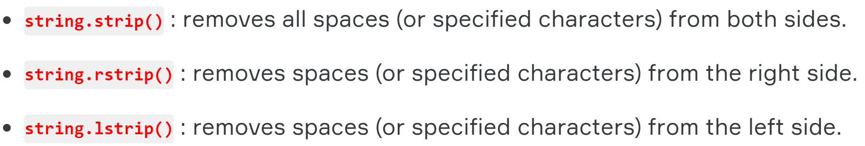
Editing a String
The summary of some common and the most important methods are as follows 👇
Notes:
…. let’s dive in to examples for better understanding

Slide 22
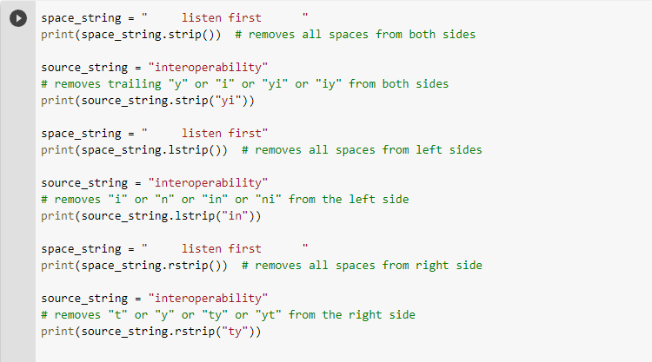
Editing a String
string.strip(arg)
string.lstrip(arg)
string.rstrip(arg)
Let’s review the pre-class examples 👇
Notes:
space_string = " listen first "
print(space_string.strip()) # removes all spaces from both sides
source_string = "interoperability"
# removes trailing "y" or "i" or "yi" or "iy" from both sides
print(source_string.strip("yi"))
space_string = " listen first"
print(space_string.lstrip()) # removes all spaces from left sides
source_string = "interoperability"
# removes "i" or "n" or "in" or "ni" from the left side
print(source_string.lstrip("in"))
space_string = " listen first "
print(space_string.rstrip()) # removes all spaces from right side
source_string = "interoperability"
# removes "t" or "y" or "ty" or "yt" from the right side
print(source_string.rstrip("ty"))

Slide 23
Editing a String
Task 👇
In the text below, accidentally there are additional letters. Remove the additional letters and make the all words uppercase.
Except for the print() line, your code should consist of a single line.
text = 'tyou can learn almost everything in pre-classz'
desired output
YOU CAN LEARN ALMOST EVERYTHING IN PRE-CLASS
Notes:
text = 'tyou can learn almost everything in pre-classz'
text = text.rstrip('z').lstrip('t').upper()
print(text)

Slide 24
Editing a String
The code may look like 👇
text = text.rstrip('z').lstrip('t').upper()
print(text)
YOU CAN LEARN ALMOST EVERYTHING IN PRE-CLASS
Notes:
text = 'tyou can learn almost everything in pre-classz'
text = text.rstrip('z').lstrip('t').upper()
print(text)

Slide 25
Collection Types
List
Tuple
Dictionary
Set
Notes:
Yes my friends, here we came to collection types. what are collection types in python.? do you know them. so you are gonna be learning lists, tuples, dictionaries and sets during this topic.
There are various collection types in Python. you can see. While types such as int and str hold a single value, collection types hold multiple values. this is the point.
In your programs, you usually need to group several items to render as a single object. We use collection types of data to do this job. let’s start with lists.

Slide 26

Lists
I’m the best...
Notes:
One of the most useful collections in Python is a list. In Python, a list is only an ordered collection of valid Python values.
The list type is probably the most commonly used collection type in Python. In spite of its name, a list is more like an array in some other languages (e.g. JavaScript).

Slide 27
Table of Contents
Creating a List
Basic Operations with Lists

Slide 28
Creating a list
We have two basic ways to create a list.
[]
list()
Notes:
A list can be created by enclosing values, separated by commas, in square brackets 👉🏻 [].
Another way to create a list is to call the list() function. we pass iterable values in into it and it creates list type data

Slide 29
Creating a list
The output :
list_1 = ['h', 'a', 'p', 'p', 'y']
word = 'happy'
list_2 = list(word)
print(list_1)
print(list_2)
[]
list()
['h', 'a', 'p', 'p', 'y']
['h', 'a', 'p', 'p', 'y']
Notes:
when we run we see that the two output are the same. list function separates the elements of the iterable that we passed into. if we separate the string happy we will have h,a,p,p,y
list_1 = ['h', 'a', 'p', 'p', 'y']
word = 'happy'
list_2 = list(word)
print(list_1)
print(list_2)

Slide 30
Creating a list (review of pre-class)
Here is example of creating a list :
Notes:
ok let’s review some pre-class examples for the best learning. what we have here. we have a simple list consisting of country names. that’s how we simply create a list. when we run it
country = ['USA', 'Brasil', 'UK', 'Germany', 'Turkey', 'New Zeland']
print(counrty)

Slide 31
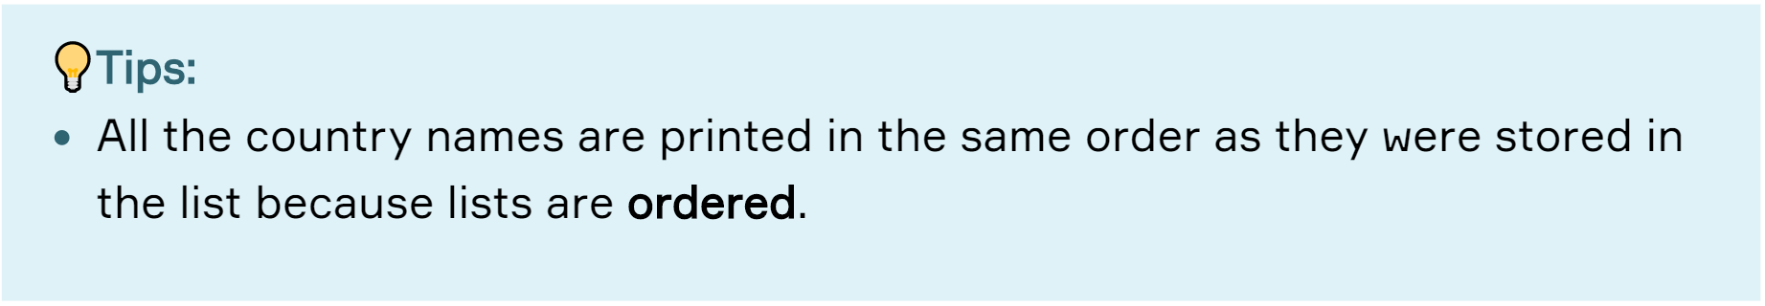
Creating a list (review of pre-class)
Here is another example of creating a list :

Slide 32
Creating a list
The components of a list are not limited to a single data type.
Here is an example :
mixed_list = [11, 'Joseph', False, 3.14, None, [1, 2, 3]]
⚠ int
⚠ str
⚠ bool
⚠ float
⚠ NoneType
⚠ list
Notes:
Python is a dynamic language. ….
we can use all collection types in a list as well. so in this example we use list in a list.
mixed_list = [11, 'Joseph', False, 3.14, None, [1, 2, 3]]

Slide 33
Creating a list
Task:
my_list = ['Aslan', 'Clarusway', 2022]
new_list1 = list(my_list)
new_list2 = [my_list]
print(new_list1)
print(len(new_list1))
print(new_list2)
print(len(new_list2))
Notes:
-------------------- this is the output---------------
yes my friend focus on my screen and my voice to follow the steps what did happen here. so what does the list function do. remember! it takes an iterable and separates its elements and creates a list from these elements. this is the definition. so regarding this definition; let’s take a look at the my list as an iterable. what are the elements of mylist. xxx, xxx, xxx are the elements of the iterable. and list function creates a list consisting of these elements. so it creates the same list again. and of course the length of this new list1 is three. ok
when it comes to using simple square brackets to create a list. you can see that we only encloses the my list by brackets. it has a one element which is mylist. we create a list in a list. nested list.
and how many elements does newlist2 have? it has only one element. right? the only element of it is the mylist.
my_list = ['Aslan', 'Clarusway', 2022]
new_list1 = list(my_list)
new_list2 = [my_list]
print(new_list1)
print(len(new_list1))
print(new_list2)
print(len(new_list2))

Slide 34
Creating a list
The output:.
['Aslan', 'Clarusway', 2022]
3
[['Aslan', 'Clarusway', 2022]]
1
Notes:
my_list = ['Aslan', 'Clarusway', 2022]
new_list1 = list(my_list)
new_list2 = [my_list]
print(new_list1)
print(len(new_list1))
print(new_list2)
print(len(new_list2))

Slide 35
Creating a list
Task:
Create a list from string value of "2022's hard".
Use both list() function and square brackets [].
Notes:
…..
Let’s see what will happen.
my_list1 = ["2022's hard"]
my_list2 = list("2022's hard")
print(my_list1)
print(my_list2)

Slide 36
Creating a list
The code :
my_list1 = ["2022's hard"]
my_list2 = list("2022's hard")
print(my_list1)
print(my_list2)
each item including spaces came into the list
each item including spaces came into the list
Each item/char including spaces came into the list
["2022's hard"]
['2', '0', '2', '2', "'", 's', ' ', 'h', 'a', 'r', 'd']
Notes:
this is my way of solution.
by using simple square brackets to create a list from the string value we have, we produce a list which has only one element.
and when it comes to creating a list using list function, we produce a list composed of the elements of this string value. each characters of the string becomes an element of the list that we created using list function. did make myself clear? so keep going
my_list1 = ["2022's hard"]
my_list2 = list("2022's hard")
print(my_list1)
print(my_list2)

Slide 37
Basic Operations with Lists
Notes:
ok from now on i would like to show you some basic and useful operations in python list

Slide 38
Basic Operations with lists
Two methods for creating an empty list.
empty_list_1 = []
empty_list_2 = list()
Notes:
….
so if you’ve learned how to create an empty list, you can see how to fill them with some data. let’s see basic methods regarding this issue.
empty_list_1 = []
empty_list_2 = list()

Slide 39
Basic Operations with lists
.append() appends an object to the end of a list.
.append()
.insert()
Notes:
ok. we have two basic methods. We can add an element into a list using .append() or .insert() methods. the first one is append method. it appends an element to the end of the list on which we apply. whenever we call and run the append function, it takes the data that we pass into and put this data to the end of the list. let’s see it in an example

Slide 40
Basic Operations with lists
.append() appends an object to the end of a list.
numbers = [1, 4, 7]
numbers.append(9)
numbers.append('9')
print(numbers)
.append()
.insert()
Notes:
since the list type is mutable type so we can change it in contradiction to the string type. so when we apply append method to a list there will be no need to assign it to a new variable for changing it. it happens automatically. what i am trying to say is that when you apply any method on a list, you will change it permanently. for better understanding let’s see the output
numbers = [1, 4, 7]
numbers.append(9)
numbers.append('9')
print(numbers)

Slide 41
Basic Operations with lists
We can add an element into a list using .append() or .insert() methods.
.append() appends an object to the end of a list.
numbers = [1, 4, 7]
numbers.append(9)
numbers.append('9')
print(numbers)
.append()
.insert()
[1, 4, 7, 9, '9']
Notes:
As you can see here, we appended two elements at the end of the list. whenever we apply this method to a list, it cumulatively adds the data one after another. and we changed the list using this method permanently.
numbers = [1, 4, 7]
numbers.append(9)
numbers.append('9')
print(numbers)

Slide 42
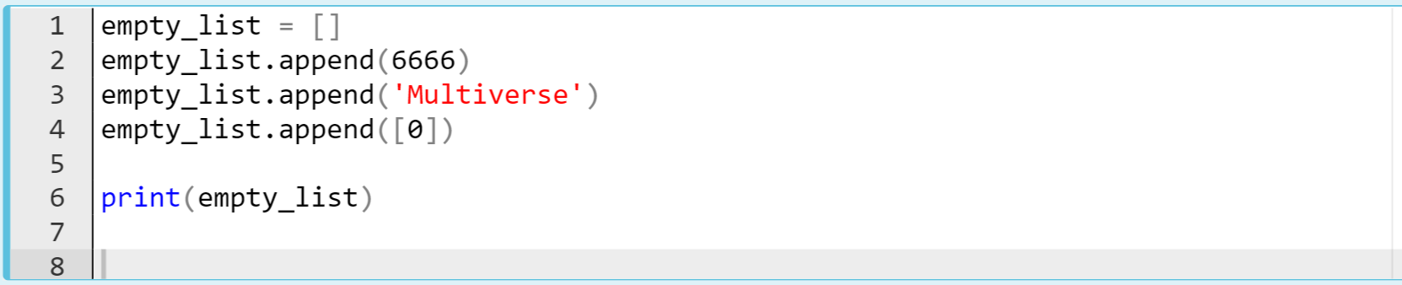
Basic Operations with lists
Take a look at the example 👇
Notes:
🍐 This is a Pear Deck Text Slide
🍐 To edit the type of question, go back to the "Ask Students a Question" in the Pear Deck sidebar.
empty_list = []
empty_list.append(6666)
empty_list.append('Multiverse')
empty_list.append([0])
print(empty_list)

Slide 43
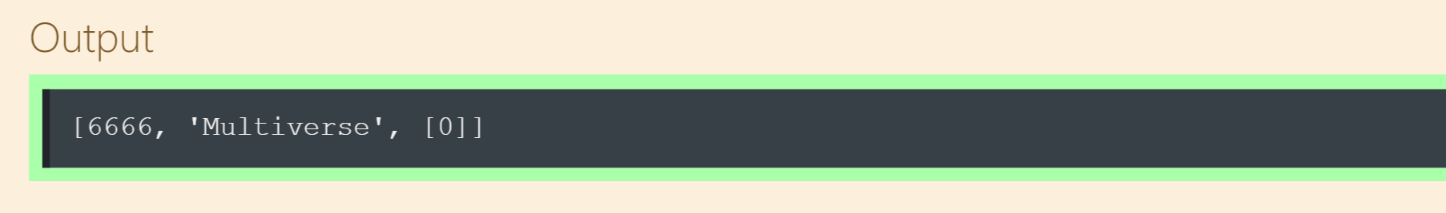
Basic Operations with lists
Take a look at the example 👇
Notes:
empty_list = []
empty_list.append(6666)
empty_list.append('Multiverse')
empty_list.append([0])
print(empty_list)

Slide 44
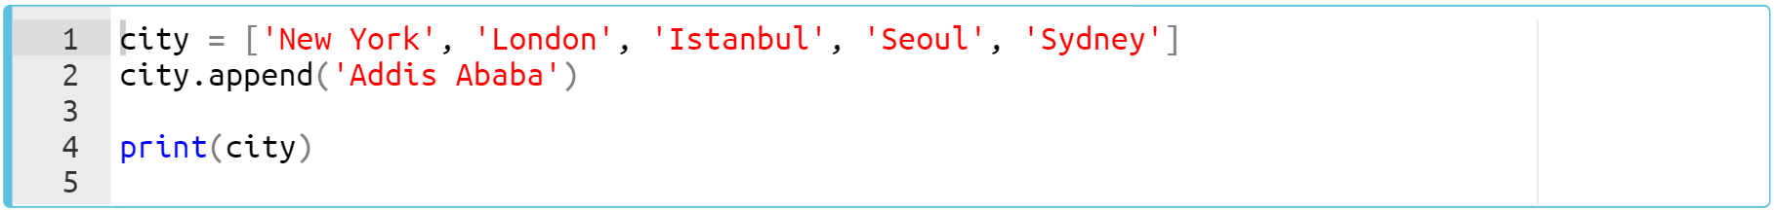
Basic Operations with lists
Here’s the pre-class example 👇
Notes:
For better understanding let’s review a pre-class example quickly.
city = ['New York', 'London', 'Istanbul', 'Seoul', 'Sydney']
city.append(‘Addis Ababa’)
print(city)

Slide 45
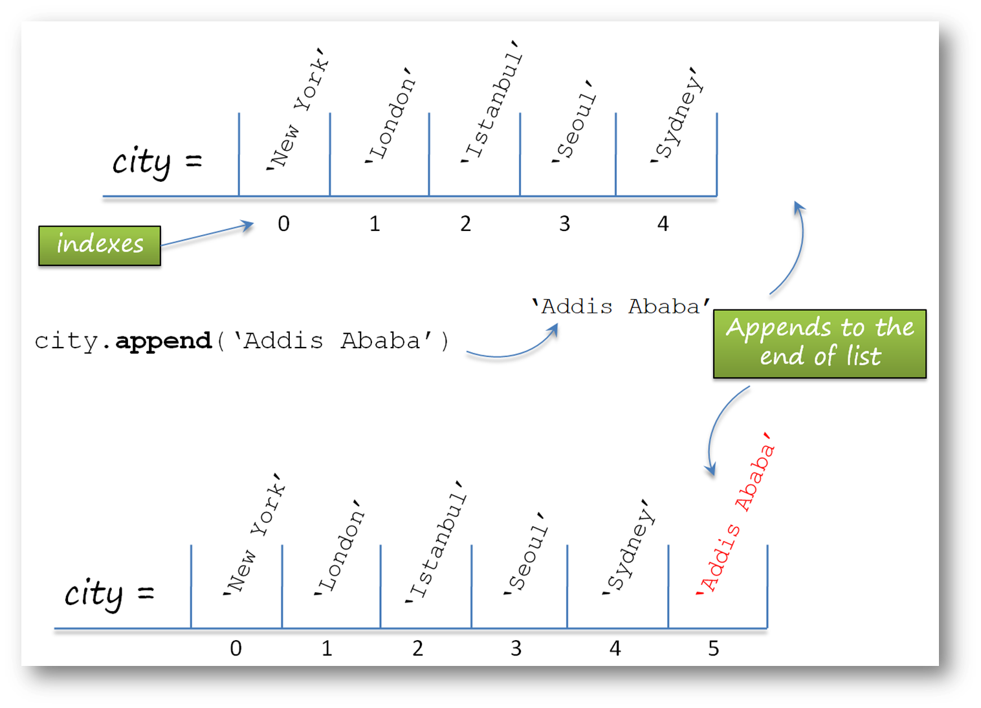
Basic Operations with lists

Slide 46
Basic Operations with lists
Notes:
city = ['New York', 'London', 'Istanbul', 'Seoul', 'Sydney']
city.append(‘Addis Ababa’)
print(city)

Slide 47
Basic Operations with lists
Task :
Create an empty list and then collect the int numbers (1 - 4) one by one into the list you created using .append() method.
Notes:
ok. here is your task.
numbers = []
numbers.append(1)
numbers.append(2)
numbers.append(3)
numbers.append(4)
print(numbers)

Slide 48
Basic Operations with lists
The code can be like :
numbers = []
numbers.append(1)
numbers.append(2)
numbers.append(3)
numbers.append(4)
print(numbers)
[1, 2, 3, 4]
Notes:
numbers = []
numbers.append(1)
numbers.append(2)
numbers.append(3)
numbers.append(4)
print(numbers)

Slide 49
Basic Operations with lists
.insert() adds a new object to the list at a specific (given) index.
.append()
.insert()
Notes:
so insert method works a little bit different from append method in terms of where the element was added to the list. the place the location of the element that we add into it. this time we specify the index number in addition to the element value itself. how we do that let’s see it in an example

Slide 50
Basic Operations with lists
.insert() adds a new object to the list at a specific (given) index.
numbers = [1, 4, 7]
numbers.insert(2, 9)
print(numbers)
numbers.insert(2, 6)
print(numbers)
.append()
.insert()
Adds into index ‘2’
Adds into index ‘2’
Adds into index ‘2’
Adds into index ‘2’
Adds into index ‘2’
[1, 4, 9, 7]
[1, 4, 6, 9, 7]
| | | | |
0 1 2 3 4
Notes:
“i am the new holder of index number two”
insert method takes two arguments. first we put the index number where we place the new element. and of course the second argument that we pass into is a new element we want to insert. the newly added element intervenes by shifting the old element to the right. it says
“i am the new holder of index number two”
numbers = [1, 4, 7]
numbers.insert(2, 9)
print(numbers)
numbers.insert(2, 6)
print(numbers)

Slide 51
Basic Operations with lists
.remove() removes the elements from the list.
.remove()
.sort()
Notes:
ok you are gonna keep learning basic methods of the lists. now we have remove and sort method.
We can remove and sort the elements of the list. so. the best way that we can learn. let’s dive into an example.

Slide 52
Basic Operations with lists
We can remove and sort the elements of the list.
.remove() removes the elements from the list.
numbers = [1, 4, 7, 9]
numbers.remove(7)
print(numbers)
.remove()
.sort()
[1, 4, 9]
Notes:
you see. it is very simple and clear. it removes the element which we specify.
numbers = [1, 4, 7, 9]
numbers.remove(7)
print(numbers)

Slide 53
Basic Operations with lists
.sort() sorts the elements in the list.
.remove()
.sort()
Notes:
It is so clear, isn’t it? Using this method, we can sort all the elements of a list in ascending order or vice versa. how we do that. let’s see it in an example again.

Slide 54
Basic Operations with lists
.sort() sorts the elements in the list.
.remove()
.sort()
numbers = [4, 1, 9, 7]
numbers.sort()
print(numbers)
[1, 4, 7, 9]
Notes:
as usual, when we run it, it sort the elements of the list in ascending order. and we have changed the list permanently. right? be careful to use these methods my friends. if the original order of the list is important, using this method may cause some undesirable situations.
numbers = [4, 1, 9, 7]
numbers.sort()
print(numbers)

Slide 55
Basic Operations with lists
.sort() sorts the elements in the list.
mix_list = ['d', 1, 'a', 7]
mix_list.sort()
print(mix_list)
Notes:
mix_list = ['d', 1, 'a', 7]
mix_list.sort()
print(mix_list)

Slide 56
Basic Operations with lists
.sort() sorts the elements in the list.
The items to be sorted in the list should be the same type.
mix_list = ['d', 1, 'a', 7]
mix_list.sort()
print(mix_list)
TypeError Traceback (most recent call last)
<ipython-input-7-ad44188425eb> in <module>
1 mix_list = ['d', 1, 'a', 7]
----> 2 mix_list.sort()
3 print(mix_list)
TypeError: '<' not supported between instances of 'int' and 'str'
Notes:
as we can see here. The items to be sorted in the list should be the same type.

Slide 57
Basic Operations with lists
Calculate the length of these lists. Do not play with Playground/IDEs, push your brains!..
list_1 = ['one', 'four', 'nine']
list_2 = ['@', '*-', 'False']
list_3 = [True, False, None]
list_4 = [[3], [44], [-12]]
list_5 = [[1, 3], [44, -40], [-12, 1]]
Notes:
list_1 = ['one', 'four', 'nine']
list_2 = ['@', '*-', 'False']
list_3 = [True, False]
list_4 = [[3], [44], [-12]]
list_5 = [[1, 3], [44, -40], [-12, 1]]

Slide 58

Accessing Lists
Come on ‘seabass’ !.. Where are you?
fishes = ['tuna', 'squid', 'seabass']
Notes:
You know that there are several types of collections for storing data in Python, like list, tuple, dictionary.
Each item or element in a list, as well as every character in a string, has an index corresponding to their location. Using indices, we can access elements within a sequence. Now, let's see how can we do that? here it is. indexing and slicing a list. In the python world, you can't take chances like the guy here. things don't work like that here. if you wanna reach sea bass then you will be able to get the sea bass easily. so let’s dive into the topic

Slide 59
Table of Contents
Indexing a List
Slicing a List
Notes:
we have three main sub topics which we will cover.

Slide 60
Indexing a list
fruit[1]
fruit = ['Apple', 'Orange', 'Banana']
list()

Slide 61
Indexing a list
To access or use the elements of a list, we can use index numbers of the list enclosed by square brackets.
list_name[index no]
word = ['h', 'a', 'p', 'p', 'y']
print(word[1])
a
Notes:
Do not start indexing with 1. The first index of the element of a list is 0. I will never stop remembering that!
word = ['h', 'a', 'p', 'p', 'y']
print(word[1])

Slide 62
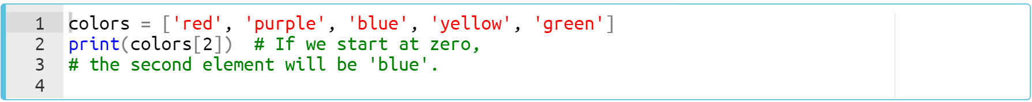
Indexing a list
Notes:
ok. Let’s consolidate our indexing knowledge throughout some pre-class examples. if we wanna access the elements which at index number is two. …. next
colors = ['red', 'purple', 'blue', 'yellow', 'green']
print(colors[2])

Slide 63
Indexing a list(review the pre-class)
Here is an example of indexing a list :
0
1
2
3
4
Notes:
you see. it's very simple.
colors = ['red', 'purple', 'blue', 'yellow', 'green']
print(colors[2])

Slide 64
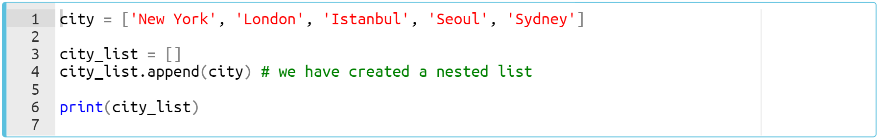
Indexing a list(review the pre-class)
Here is another pre-class example of indexing a nested list.
Notes:
city = ['New York', 'London', 'Istanbul', 'Seoul', 'Sydney']
city_list = []
city_list.append(city)
print(city_list)

Slide 65
Indexing a list(review the pre-class)
Here is another pre-class example of indexing a nested list.
How many items do the city list have?
Notes:
how many items do the city list have? let me put it in a different word, so what is the length of the city_list.
city = ['New York', 'London', 'Istanbul', 'Seoul', 'Sydney']
city_list = []
city_list.append(city)
print(city_list)

Slide 66
Indexing a list
Let’s access city_list’s first and the only element.
Notes:
so the answer is istanbul. we access the index number two. and index number two holds istanbul which is a string type, right? so consider this one
city_list = [['New York', 'London', 'Istanbul', 'Seoul', 'Sydney']]
print(city_list[0])
city_list = [['New York', 'London', 'Istanbul', 'Seoul', 'Sydney']]
print(city_list[0][2])

Slide 67

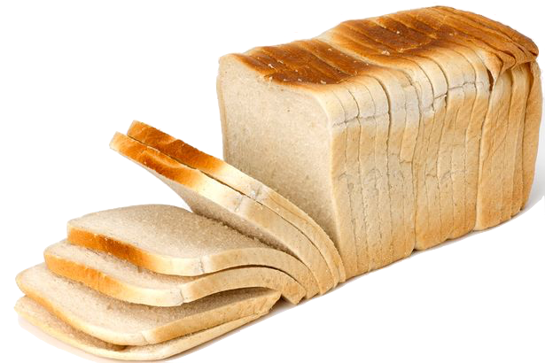
Slicing a list
[
]
Notes:
so my friends, you have learned how we access the individual elements of a list. which means “indexing a list.” now, we will talk about more than one element, more than one items of a list.

Slide 68
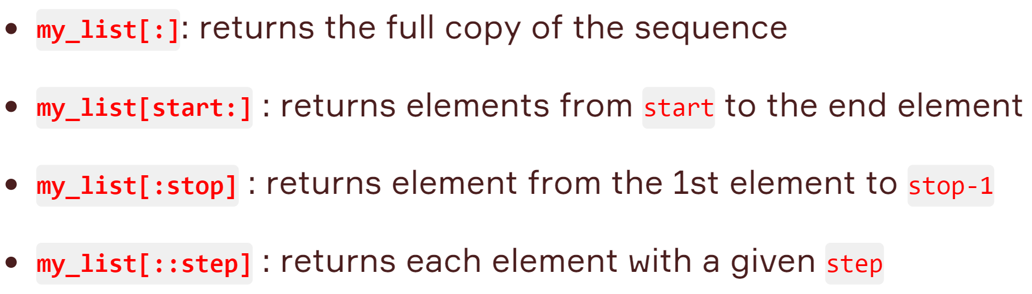
Slicing a list
Usage options of slicing are as follows :
Notes:
Each part of the slice has a default value in the list, so they are optional. If we don't assign a value to the start index, it is considered to be 0; if we don't assign a value to the stop index, it will be the same as the length of the sequence.

Slide 69
Slicing a list (review the pre-class)
Notes:
animals = ['elephant', 'bear', 'fox', 'wolf', 'rabbit', 'deer', 'giraffe']
print(animals[:])
animals = ['elephant', 'bear', 'fox', 'wolf', 'rabbit', 'deer', 'giraffe']
print(animals[3:])
animals = ['elephant', 'bear', 'fox', 'wolf', 'rabbit', 'deer', 'giraffe']
print(animals[:5])
animals = ['elephant', 'bear', 'fox', 'wolf', 'rabbit', 'deer', 'giraffe']
print(animals[::2])

Slide 70
Slicing a list
Task :
Create a list of numbers from 1 to 10 using range() function and select odd ones by slicing method and then print the result.
Notes:
tataaam. please focus on my screen and read the task carefully. …. you should get familiar with “range” function from your pre-class. ….== next ==
odd_numbers = list(range(11))
print(odd_numbers)
print(odd_numbers[1:11:2])

Slide 71
Slicing a list
Task :
Create a list of numbers from 1 to 10 using range() function and select odd ones by slicing method and then print the result.
Review the function
range(start,stop,step) function returns an object that produces a sequence of integers from start (including) to stop (excluding) by step.
Notes:
How many of you have seen this function for the first time. The importance of pre-classes is highlighted here once again. If you had worked with pre-class, you would know what/how the range function is use for. ok then please take a look the definition and usage of the range function here
odd_numbers = list(range(11))
print(odd_numbers)
print(odd_numbers[1:11:2])

Slide 72
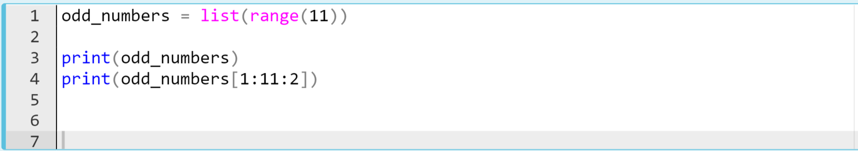
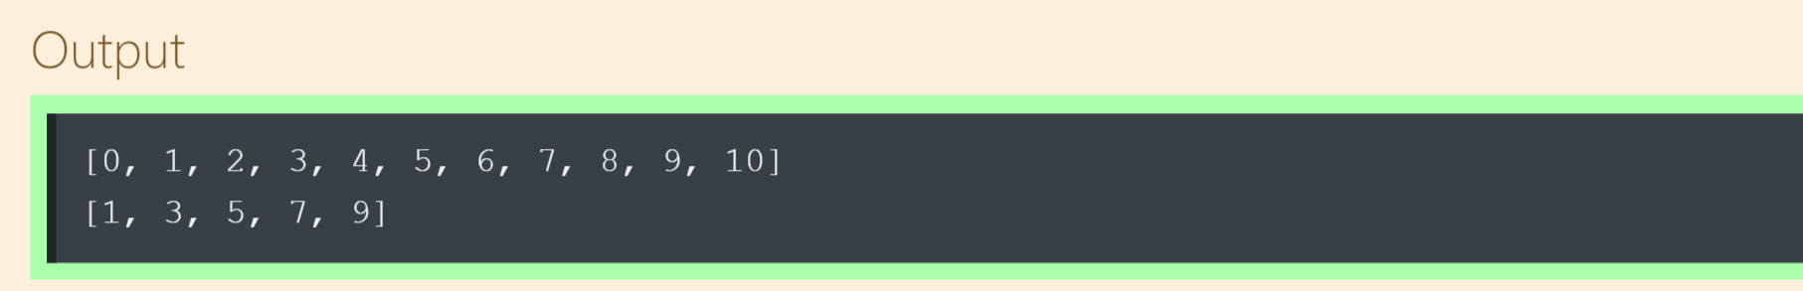
Slicing a list
The code can be like :
Notes:
we create a list using list function. we pass an iterable into the list function and it separates the production of range function into its elements. it start from 0 and goes to the stop minus one. so it is ten. from zero to ten. if we slice the odd numbers from this list. what will we have to do?
It should start from the index one and go to the end by skipping one by one. so to skip one step i should set the step parameter two.
odd_numbers = list(range(11))
print(odd_numbers)
print(odd_numbers[1:11:2])

